Slide 1
HMH Science Dimensions
Biology
Unit 1: Living Systems
Notes:
The learning experiences in this unit prepare students for the mastery of
Performance Expectations
LS1-2 Develop and use a model to illustrate the hierarchical organization of interacting systems that provide specific functions within multicellular organisms.
LS1-3 Plan and conduct an investigation to provide evidence that feedback mechanisms maintain homeostasis.
ETS1-2 Design a solution to a complex real-world problem by breaking it down into smaller, more manageable problems that can be solved through engineering.
ETS1-3 Evaluate a solution to a complex real-world problem based on prioritized criteria and trade-offs that account for a range of constraints, including cost, safety, reliability, and aesthetics, as well as possible social, cultural, and environmental impacts.

Slide 2

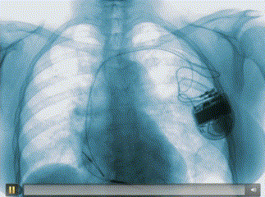
Living Systems
Unit 1
The human heart is one component in a larger, living system.

Slide 3

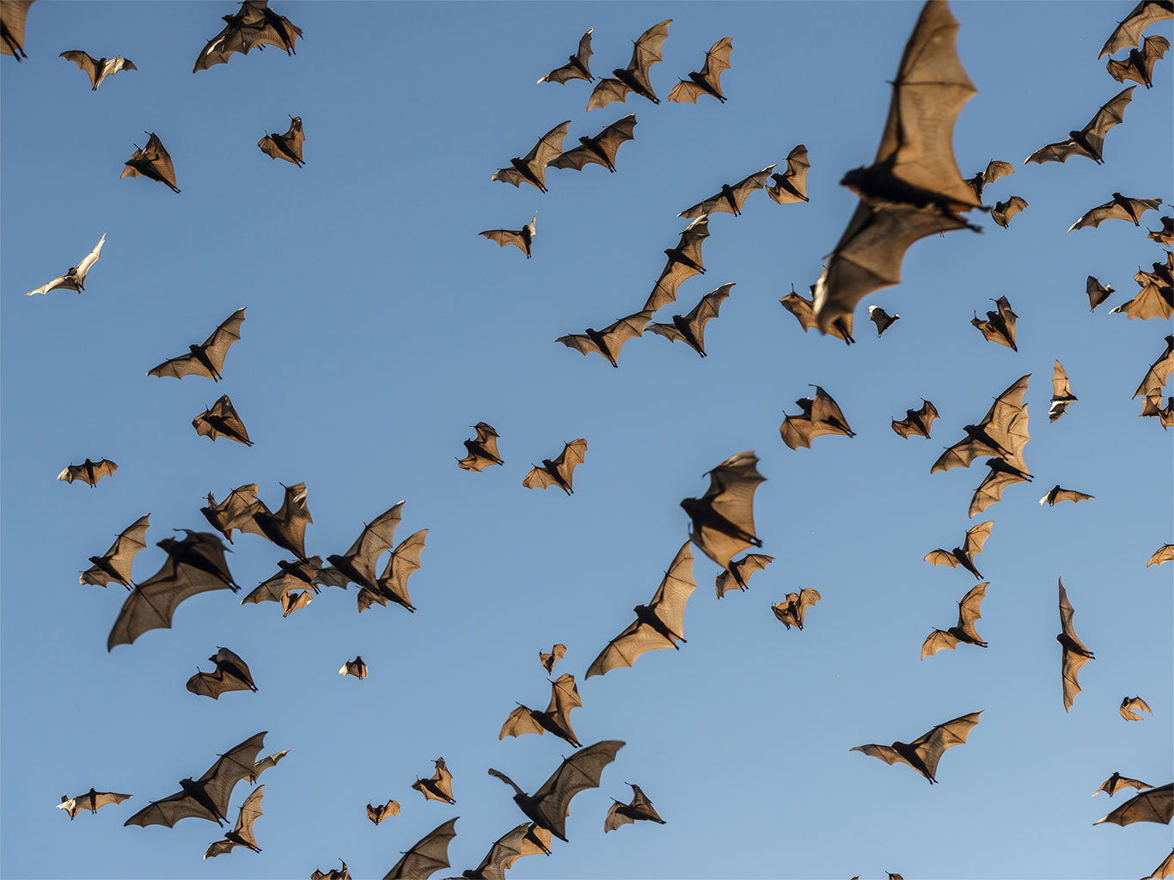
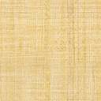
Living Systems
Unit 1
How do you think living systems such as bats carry out life functions and respond to changes in their environment?
Each bat is a living system.

Slide 4
Driving Questions
Unit 1
As you move through the unit, gather evidence to help you answer the following questions:
What are the levels of organization within the Earth system?
How do systems in living things interact to maintain the organism?
How does the structure of cells relate to different functions and specialization?
How have advances in technology influenced human health and society?

Slide 5

Unit Project
Unit 1
Investigating Plant Systems
  Can you explain the levels of organization within your seedlings and the environment, from cells to ecosystem?

Slide 6
Unit Review
Unit 1
Synthesize the Unit
Make a concept map, other graphic organizer, or outline using the Study Guides you made for each lesson in this unit. Be sure to use evidence to support your claims.
When synthesizing individual information, remember to follow these general steps:
Find the central idea of each piece of information.
Think about the relationships among the central ideas.
Combine the ideas to come up with a new understanding.

Slide 7
Image Credits
Unit 1
flying bats ©Visionary Earth/Shutterstock; rotating MRA chest scan video ©Photolibrary Video/Science Photo Library/Getty Images

